Slide 1

Cost of Living Analysis
AMAR RAI
Nandhini Nallathambi
Siyuan LiAng
Vivian Nnadozie

Slide 2
Table of Contents
Topic | Slide Number
INTRODUCTION | 3
DATA EXPLORATION AND CLEANING | 4
COST OF LIVING AND OTHER INDEXES | 5
WHY G8 COUNTRIES FOR COMPARISON? | 6, 7
UK, IN COMPARISON WITH THE OTHER G8 COUNTRIES | 8
THE BIGGEST IMPACT ON COST OF LIVING | 9, 10
LOCAL PURCHASING POWER | 11
EXPLANATORY DATA ANALYSIS | 12, 13
COST OF LIVING HEATMAP | 14
CONCLUSIONS AND LIMITATIONS | 15, 16

Slide 3

Introduction
Cost of Living is the cost of maintaining a certain standard of living.
Amplified by the global health crisis and the conflict in Ukraine, skyrocketing inflation and currency volatility are affecting international economic balances and the cost of living for each of us. (Mercer, 2022)
In this project we are analysing the Cost of Living Index data with G8 countries and understand where the United Kingdom stands.
We are also analysing how the other indexes impact Cost of Living.
Picture Source: https://www.unison.org.uk/news/general-secretary-blog/2022/04/blog-uk-government-can-and-must-act-on-cost-of-living/

Slide 4

Data Exploration and Cleaning
We have used the datasets from Kaggle and Numbeo.
Both are simple datasets with columns for Rank, Country / City, Cost of Living Index, Rent Index, Cost of Living Plus Rent Index, Groceries Index, Restaurant Price Index and Local Purchasing Power Index.
We cleaned up the data by adding, deleting and splitting up of columns for ease of use.*
We also filtered out the data based on our requirement to analyse the performance of UK with that of countries with similar economic status.*
* See Data_Exploration_CleanUp.ipynb for details.
Picture Source: https://excelkid.com/15-ways-to-clean-data-in-excel/

Slide 5
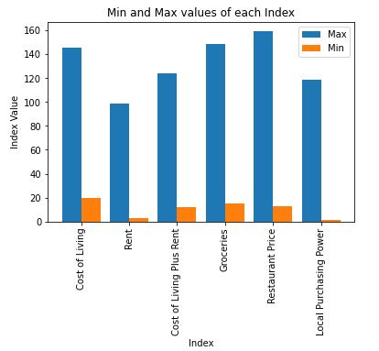
Cost of Living and other Indexes
According to Numbeo, these indexes are relative to New York City (NYC). (Numbeo, 2022)
Cost of Living Index (Excl. Rent) is a relative indicator of consumer goods prices, including groceries, restaurants, transportation and utilities.
Rent Index is an estimation of prices of renting apartments.
Groceries Index is an estimation of grocery prices.
Restaurants Index is a comparison of prices of meals and drinks in restaurants and bars.
Cost of Living Plus Rent Index is an estimation of consumer goods prices including rent.
Local Purchasing Power Index shows relative purchasing power in buying goods and services in a given city for the average net salary in that city.
See Numbeo Motivation and Methodology for more details on indexes and calculation.

Slide 6
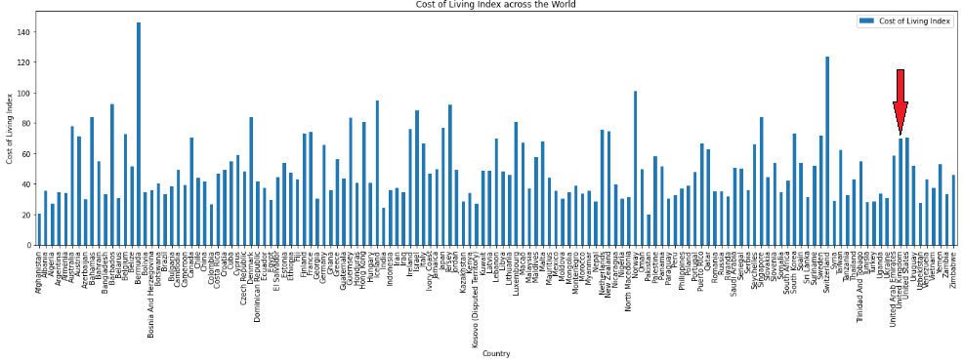
Why G8 countries for comparison?
The dataset has around 170 countries.
To make it more realistic we decided to compare the performance of UK with a subset of countries.
Continued..

Slide 7
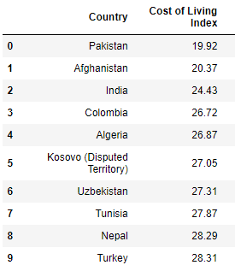
Why G8 countries for comparison?
..Continued
The top 10 countries by Cost of Living Index are developing nations and their economic structure is very different from that of UK and so these cannot be compared.
The G8 countries are not strictly the largest in the world nor the highest-income per capita, but they do represent the largest high-income countries. So we decided to use the G8 countries for this analysis. (Wikipedia, 2022)

Slide 8
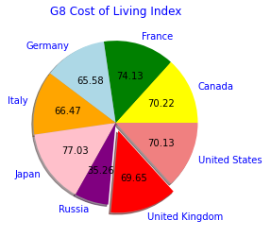
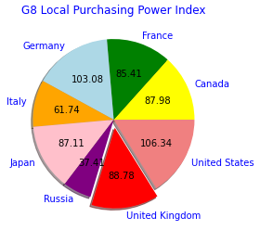
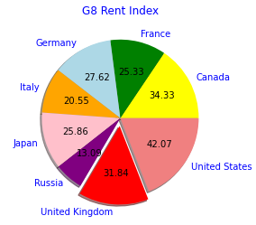
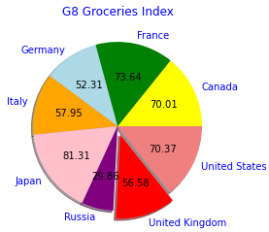
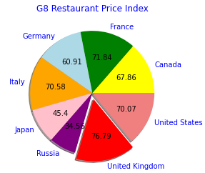
UK, in comparison with the other G8 countries
We decided to start our analysis by studying the different cost indexes for the G8 countries in comparison to the UK. We plotted some bar and pie charts for this.
As our pie charts show, Japan has the highest cost of living at 77.03 amongst the G8 and the highest groceries index at 81.31 compared to the UK which holds 69.65 and 56.58 respectively.
The US has the highest rent index at 42.07 compared the UK’s 31.84.
The UK has the highest restaurant price index at 76.79 and the US has the highest local purchasing power index at 106.34 compared to the UK’s 88.78.
But what stands out is that Russians have the least indexes compared to the rest.

Slide 9
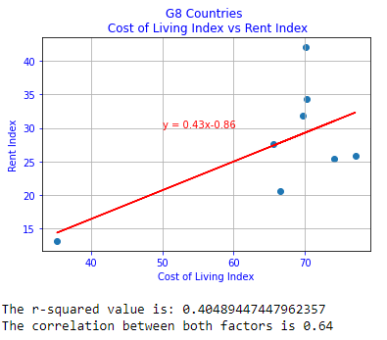
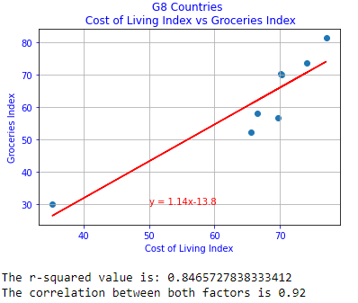
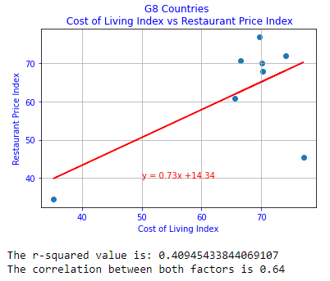
The biggest impact on Cost of Living
These plots are based on the index values of the G8 countries.
While all the 3 indexes (Rent, Groceries and Restaurant Price) have a strong relationship with the Cost of Living index, the impact of Groceries Index on Cost of Living Index is higher.
Continued..

Slide 10
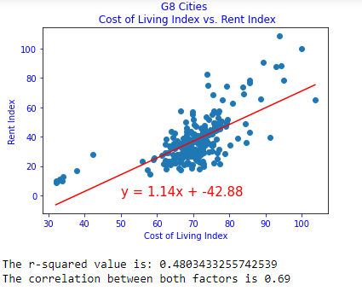
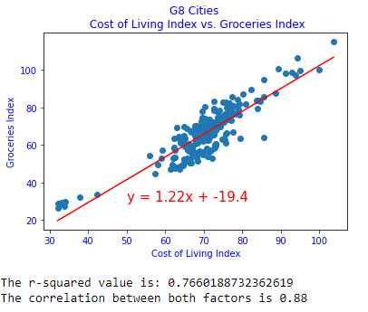
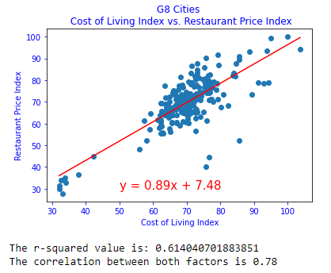
The biggest impact on Cost of Living
..Continued
These plots are based on the index values of the G8 cities.
These graphs also confirm that all the 3 indexes (Rent, Groceries and Restaurant Price) have a strong relationship with the Cost of Living index but the impact of Groceries Index on Cost of Living Index is higher.

Slide 11
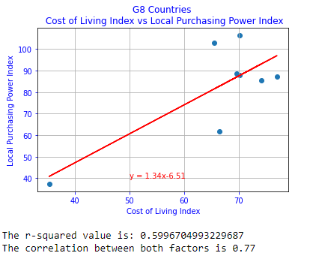
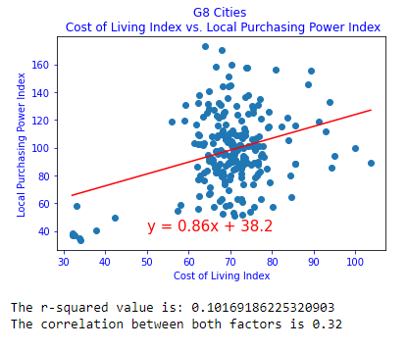
Local Purchasing Power Index
These plots for the relationship between the Cost of Living index and LPP index values show that the relationship is strong when plotted based on country’s index value.
However, when plotted by using the index values of cities, it shows that the relationship is weak.

Slide 12
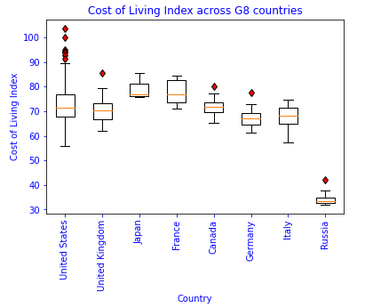
Explanatory Data Analysis Cost of Living Index
This box plot is based on the Cost of Living Index of the G8 cities.
While the distribution for UK, Canada, Germany and Italy are close to symmetric (normal distribution), that of the US, Japan, France and Russia are positively skewed (skewed right).
In comparison, the cost of living in the cities in UK, US, Canada, Germany and Italy seem to be in the similar range while that of the cities in Germany and France seem to be higher and that is Russia is less.
The outlier here for the UK is that of London which shows that the cost of living in London is way higher than the other major cities.
The cost of living index across the major US cities is widely spread.

Slide 13
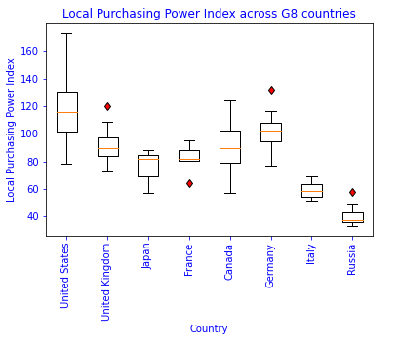
Explanatory Data Analysis Local Purchasing Power Index
This box plot is based on Local Purchasing Power Index of the G8 cities.
While the distribution for the US, UK, Canada, Germany and Italy are close to symmetric (normal distribution), that of Japan is negatively skewed (skewed left), France and Russia are positively skewed (skewed right).
In comparison, the local purchasing power in the cities in UK and Canada seem to be in the similar range.
The outlier here for the UK is that of Derby which shows that the local purchasing power in Derby is way higher than the other major cities.
The local purchasing power index across the major cities in US and Canada are widely spread.

Slide 14
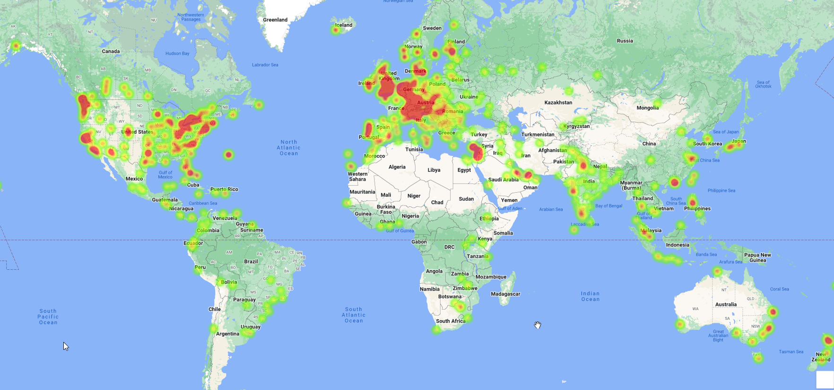
Cost of Living Heatmap

Slide 15
Conclusions
The United Kingdom stands 5th in terms of Cost of Living amongst the G8 countries. However in terms of Local Purchasing Power, UK seem to be doing better than most, standing 3rd. Only Germany’s numbers are better with a lower Cost of Living (6th) and higher Local Purchasing Power (2nd).
It is interesting that the Local Purchasing Power has a strong correlation with Cost of Living. Ideally, the decrease in the Local Purchasing Power causes serious negative economic consequences leading to the increase in Cost of Living. (Hayes, 2022)
As expected, all the 3 indexes for Rent, Groceries and Restaurant Price have a strong impact on Cost of Living. Groceries Index has a very high impact on Cost of Living Index.
Looking at the box plots for cost of living and local purchasing power, London is the most expensive city within the UK. The other cities seem to be within the national range for both cost of living and local purchasing power.

Slide 16
Limitations
Numbeo uses user inputs and data from the government websites to calculate the indexes. This may not necessarily give the correct picture.
The dataset used is from early 2020 and so may not represent the current status.
The index values for cities and aggregate values for country have discrepancies. As per Numbeo, the data points for a county is much more than those for individual cities.

Slide 17
References
Hayes, A., 2022. Investopedia. [Online] Available at: https://www.investopedia.com/terms/p/purchasingpower.asp [Accessed 16 October 2022].
Mercer, 2022. Mercer. [Online] Available at: https://www.mercer.com/our-thinking/career/cost-of-living.html [Accessed 15 October 2022].
Numbeo, 2022. Numbeo. [Online] Available at: https://www.numbeo.com/cost-of-living/cpi_explained.jsp [Accessed 16 October 2022].
Wikipedia, 2022. Wikipedia. [Online] Available at: https://en.wikipedia.org/wiki/G8 [Accessed 15 October 2022].

